Slide 1
Netflix Content Performance Evaluation
Analysis and Visuals created with Power Bi
Created by Team Work
#30DaysDataChallengewithAnnie

Slide 2
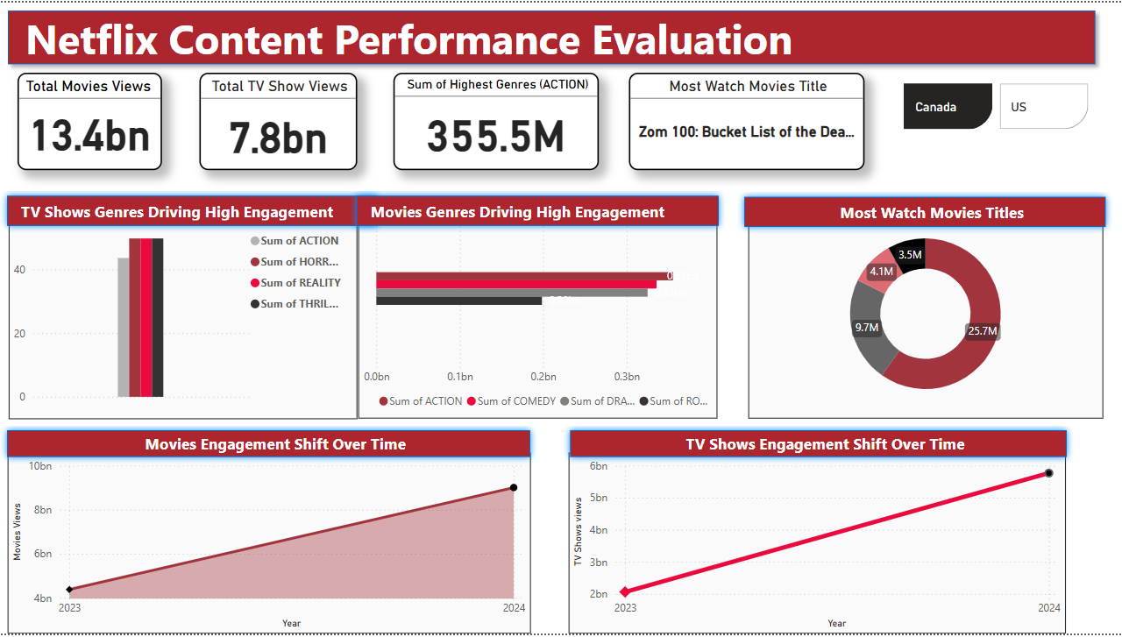
NETFLIX CONTENT PERFORMANCE EVALUATION

Slide 3
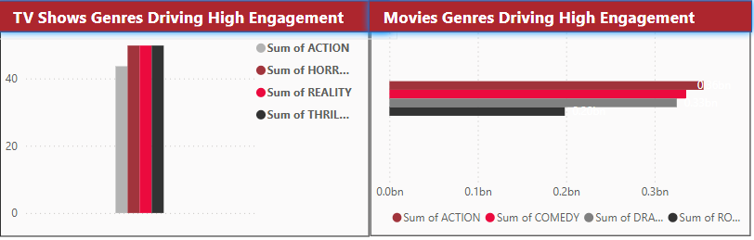
Performance Overview For TV Shows
Action, Horror, Reality, and Thriller genres all show relatively high engagement, with Action leading the pack in TV show categories.
Recommendations & Solutions:
Diversify offerings across these top genres. Promote reality and thriller series more aggressively, especially in markets with rising interest in non-fiction content.
Performance Overview For Movies
Action dominates in movie engagement, followed by other genres. This reinforces viewer preferences for energetic, plot-heavy films.
Recommendations & Solutions:
Increase investment in blockbuster-style action movies while testing hybrid genres (e.g., horror-action or action-comedy) to widen appeal.

Slide 4
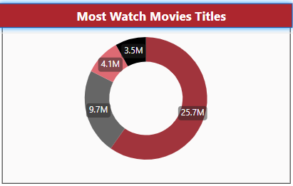
Performance Analysis
The leading movie has 25.7M views, followed by others with 9.7M, 4.1M, and 3.5M. A clear gap suggests strong interest in a few standout titles.
Recommendations & Solutions:
Promote underperforming but quality titles using personalized recommendations. Analyze what worked for top movies and replicate marketing strategies.

Slide 5
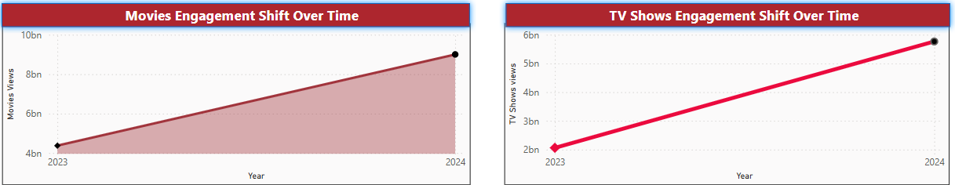
Performance Analysis
There’s a clear upward trend in movie engagement, increasing from ~4bn in 2023 to ~9bn in 2024, showing growing audience interest.
Recommendations & Solutions:
Capitalize on this trend by maintaining a steady release calendar. Monitor which months or seasons drive peak engagement for smarter scheduling.
Performance Analysis:
TV show views have also increased from ~2bn in 2023 to ~5bn in 2024, indicating healthy growth in serialized content consumption.
Recommendations & Solutions:
Sustain growth by improving binge-watch experiences and launching follow-up seasons of successful series. Leverage user data to recommend trending shows more effectively.

Slide 6
Netflix Content Performance Evaluation
CONCLUSION
The dashboard shows strong performance in both movies and TV shows, with movies leading in total views. Action is the top genre across both formats, drawing the highest engagement. Titles like (Zom 100:) highlight audience interest in unique, thrilling content. Engagement has grown significantly from 2023 to 2024 across United States and Canada. Netflix should focus on top genres, audience data, and consistent content release to sustain this growth

